Slide 1
Trust Administration Mobile
App

Slide 2

Team Introduction
Chris Wilson
Video games, rocks/fossils, graphic art design
Ja’von Elliott
Video games, sports, family
Drew Ellery
Video games, board games, sports
Nick Bartling
Video games, Music, Photography

Slide 3

Company Overview
Client: Accutech
Iris Lewis-Beasley
Business Analyst
Provide Software
Cheetah , Accutech Gold
Who uses this software?
Financial Management without:
Stockholder, directors, venture capitalists

Slide 4

The First Meeting
Conference Call
In a lab of Robert Bell
Talked with Iris Lewis-Beasley
Very professional

Slide 5

The Second Meeting
Webex Meeting
Lasted about an hour
Software walkthrough
Gathered majority of functional requirements

Slide 6

Cheetah
Browser based software
Acts as an competitor
Provides efficiency and simplicity
Features:
Approvals, account management, task, activities, relationships, etc.

Slide 7
Our Job
MOBILIZE CHEETAH

Slide 8

Our Tools
Xamarin
Cross-platform Compatibility
C# Native Code
Open-source

Slide 9

High-Level Features
Activities & Tasks
Administrator View
Approvals
“Super Search”
Documents
Portfolio View
Relationships
Login
Transactions

Slide 10
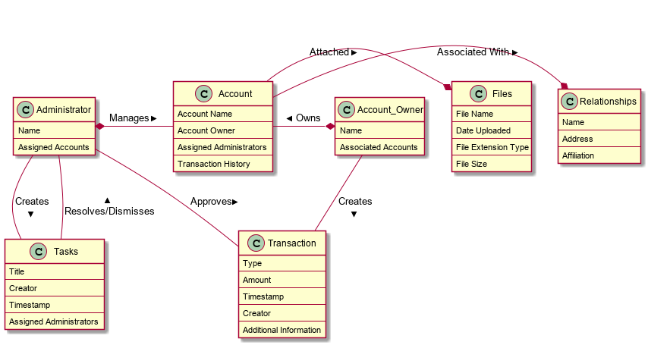

Slide 11
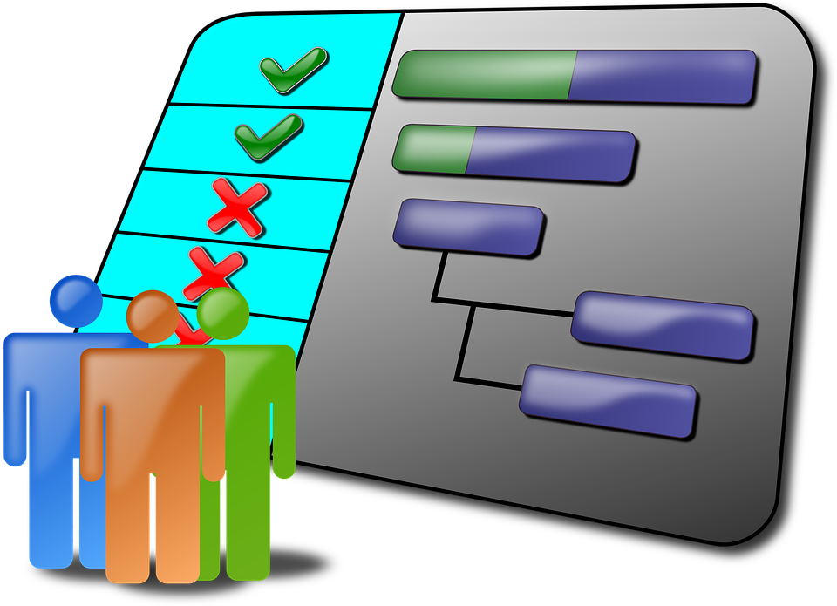
First Iteration
Login
Tasks & Activities
Home Screen & Navigation

Slide 12

Future Iterations
Second Iteration
Transactions & Approvals
Relationships

